Slide 1


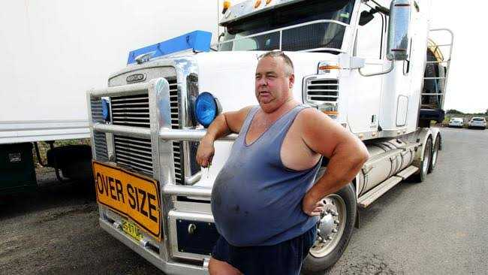
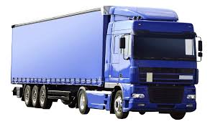
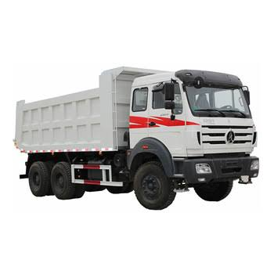
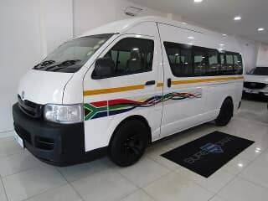
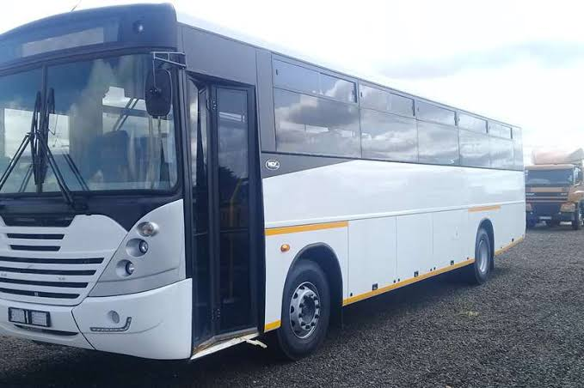
Fleet Tracking System
BROUGHT TO YOU BY BUSINESS ONLINE
DO YOU NEED A TRUCK?
DO YOU HAVE A COMPANY?
DO YOU NEED A DRIVER?
FROM A RANGE OF TRUCKS, BUSES AND VEHICLES THAT SUIT YOUR NEEDS
YOU DON’T NEED ME TO CONVINCE YOU OTHERWISE ☺ ☺
IMPRESSED, THEN PRESS THAT DEVICE AND PURCHASE ANY TRUCK FROM OUR RANGE OF VEHICLES THAT CAN MEET ANY OF YOUR BUSINESS DEMANDS
YOU HAVE COME TO THE RIGHT PLACE, WHERE YOU CAN GET A PART, A TRUCK OR A DRIVER FOR ALL YOUR BUSINESS NEEDS
BUSINESS ONLINE IS HERE TO HELP.
THE FLEET TRACKING SYSTEM
OUR SYSTEM, THE FLEET TRACKING SYSTEM OFFERS MORE THAN A TRACKING FOR EVERY TRIP MADE
IT HAS A LOT OF FUNCTIONALITIES FOR YOUR BUSINESS BENEFIT, ASK US HOW AND WILL LET YOU KNOW
BUSINESS ONLINE PRESENTS TO YOU
NEED A DRIVER, DOES THIS DRIVER WORK FOR YOUR COMPANY?

